Slide 1
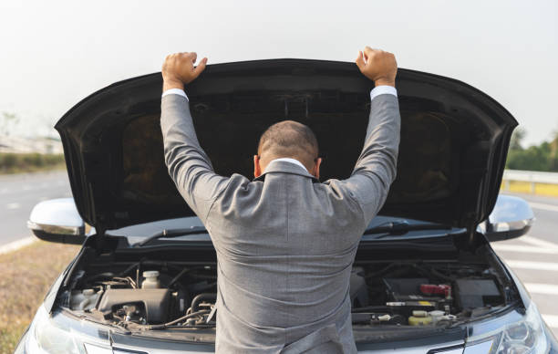
Hoe werken modellering/simulatie paketten?

Slide 2
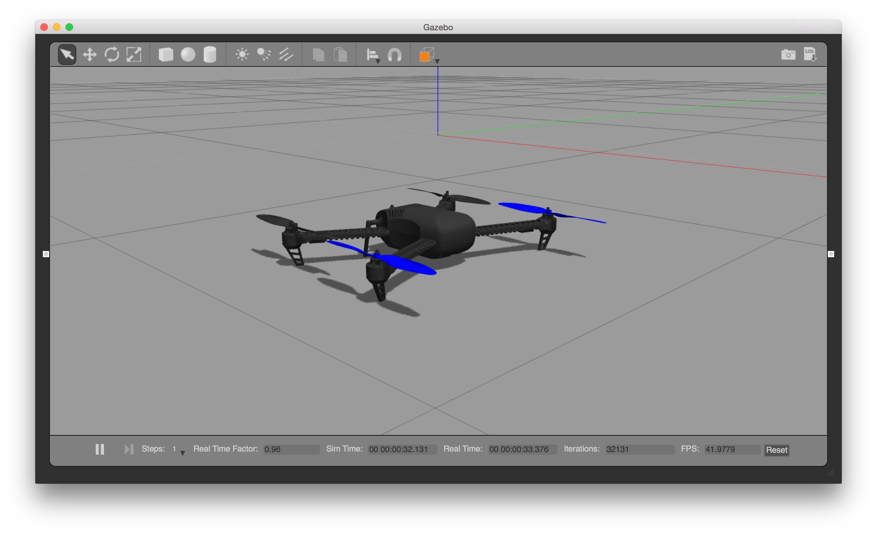
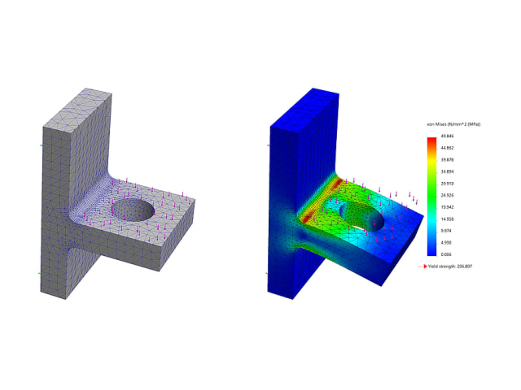
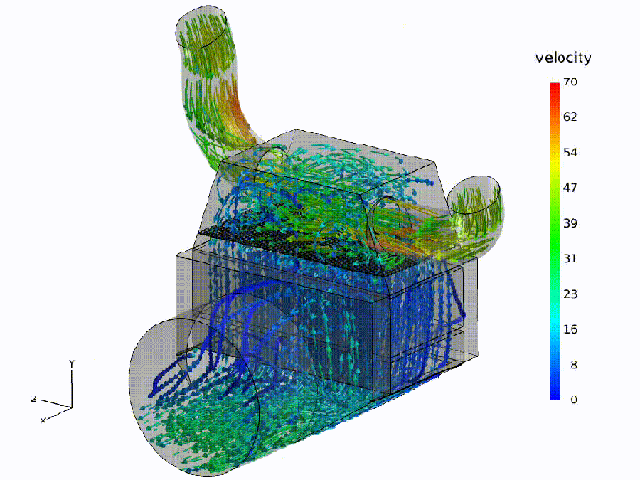
Gazebo / Unity / Unreal / …
Finite Element Analysis
(eindige elementen analyse)
Navier Stokes, Monte Carlo, etc..

Slide 3

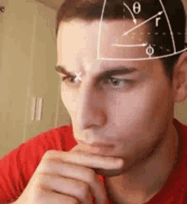
Je zit in de auto…
Je rijdt 120 km/hr…
Je passeert een kilometer paaltje : 235km
Bij welk kilometer paaltje ben je 30 minuten later?

Slide 4
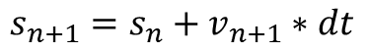
Je zit in de auto…
Je rijdt 120 km/hr…
Je passeert een kilometer paaltje : 235km
Bij welk kilometer paaltje ben je 30 minuten later?
In feite heb je een differentievergelijking opgelost!
$${Position}_{new}={Position}_{old}+Speed∗ ∆time$$
$$s_{n+1}=s_{n}+v_{n+1}∗dt$$

Slide 5
M

Slide 6
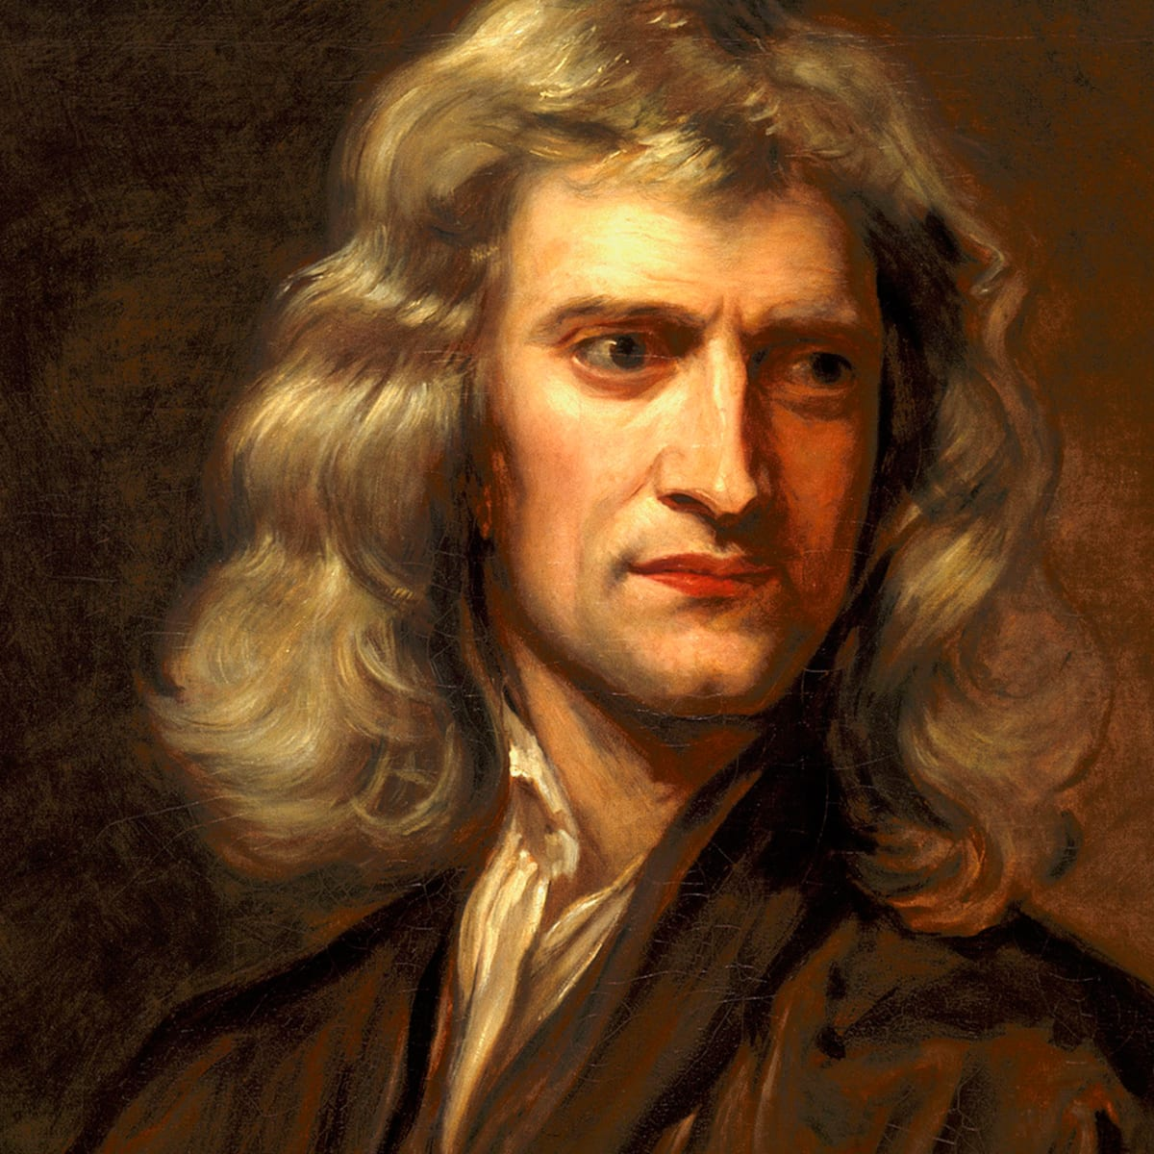
Bewegende dingen????
1687

Slide 7
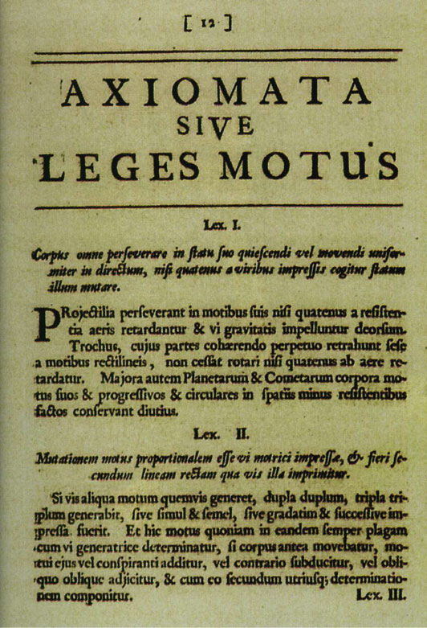
Geen kracht -> geen verandering van snelheid

Slide 8
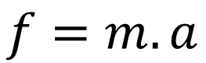
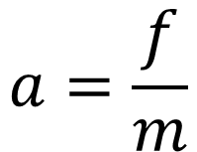
Kracht
$$a=\frac{f}{m}$$
$$f=m.a$$
Versnelling
Massa

Slide 9
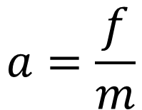
$$a=\frac{f}{m}$$
M

Slide 10
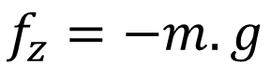
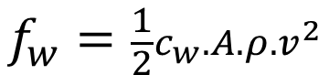
$$a=\frac{f}{m}$$
M
$$f_{z}=−m.g$$
$$f_{w}=\frac{1}{2}c_{w}.A.ρ.v^{2}$$

Slide 11
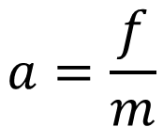
M
$$f_{z}=−m.g$$
$$f_{w}=\frac{1}{2}c_{w}.A.ρ.v^{2}$$
$$a=\frac{f}{m}$$

Slide 12
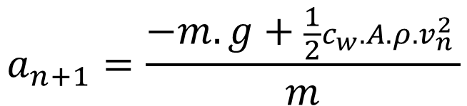
M
$$f_{z}=−m.g$$
$$f_{w}=\frac{1}{2}c_{w}.A.ρ.v^{2}$$
$$a_{n+1}=\frac{−m.g+\frac{1}{2}c_{w}.A.ρ.v_{n}^{2} }{m}$$

Slide 13
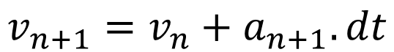
M
$$f_{z}=−m.g$$
$$f_{w}=\frac{1}{2}c_{w}.A.ρ.v^{2}$$
$$a_{n+1}=\frac{−m.g+\frac{1}{2}c_{w}.A.ρ.v_{n}^{2} }{m}$$
$$v_{n+1}=v_{n}+a_{n+1}.dt$$

Slide 14
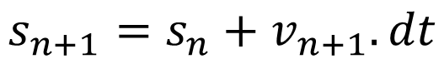
M
$$f_{z}=−m.g$$
$$f_{w}=\frac{1}{2}c_{w}.A.ρ.v^{2}$$
$$a_{n+1}=\frac{−m.g+\frac{1}{2}c_{w}.A.ρ.v_{n}^{2} }{m}$$
$$v_{n+1}=v_{n}+a_{n+1}.dt$$
$$s_{n+1}=s_{n}+v_{n+1}.dt$$

Slide 15
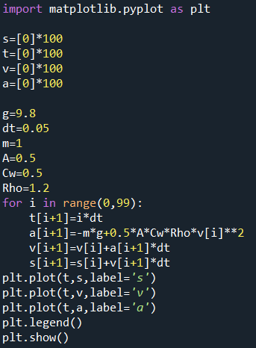
$$f_{z}=−m.g$$
$$f_{w}=\frac{1}{2}c_{w}.A.ρ.v^{2}$$
$$a_{n+1}=\frac{−m.g+\frac{1}{2}c_{w}.A.ρ.v_{n}^{2} }{m}$$
$$v_{n+1}=v_{n}+a_{n+1}.dt$$
$$s_{n+1}=s_{n}+v_{n+1}.dt$$

Slide 16
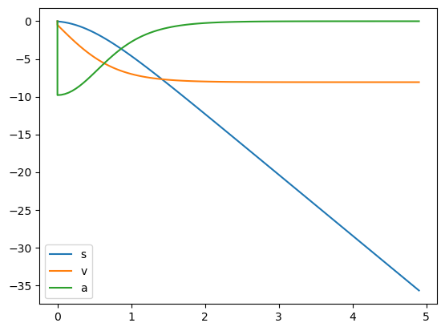
$$f_{z}=−m.g$$
$$f_{w}=\frac{1}{2}c_{w}.A.ρ.v^{2}$$
$$a_{n+1}=\frac{−m.g+\frac{1}{2}c_{w}.A.ρ.v_{n}^{2} }{m}$$
$$v_{n+1}=v_{n}+a_{n+1}.dt$$
$$s_{n+1}=s_{n}+v_{n+1}.dt$$

Slide 17
Gazebo / Unity / Unreal / …
Finite Element Analysis
(eindige elementen analyse)
Navier Stokes, Monte Carlo, etc..

Slide 18
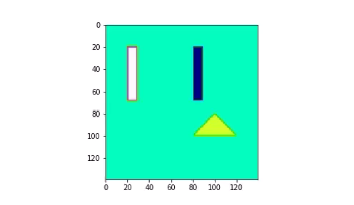
2d simulation

Slide 19
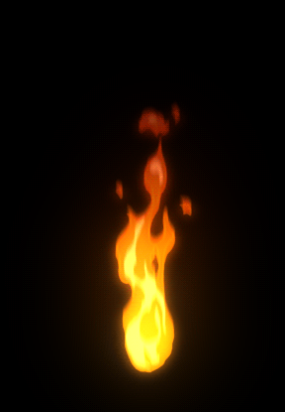
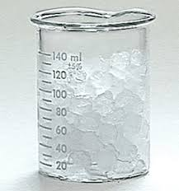
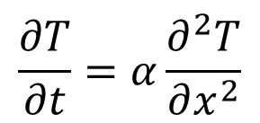
A
$$\frac{∂T}{∂t}=α\frac{∂^{2}T}{∂x^{2}}$$

Slide 20
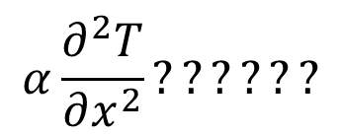
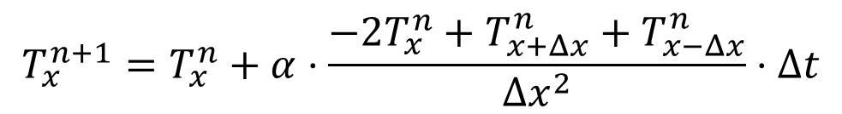
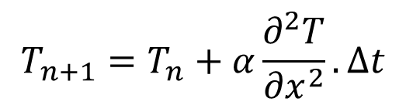
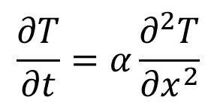
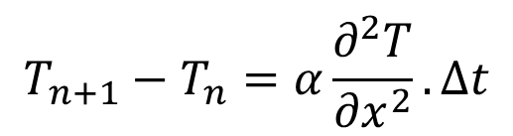
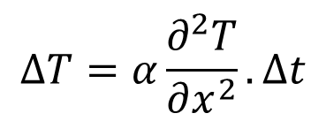
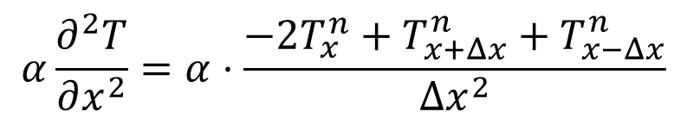
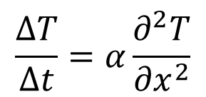
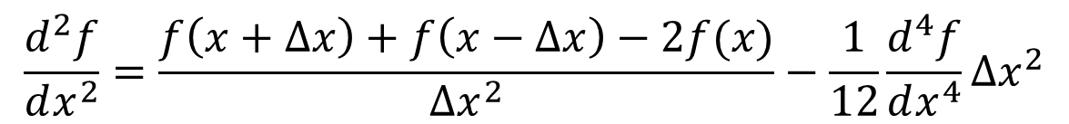
$$\frac{∂T}{∂t}=α\frac{∂^{2}T}{∂x^{2}}$$
$$α\frac{∂^{2}T}{∂x^{2}}??????$$
$$\frac{∆T}{∆t}=α\frac{∂^{2}T}{∂x^{2}}$$
$$\frac{d^{2}f}{dx^{2}}=\frac{f\left(x+Δx\right)+f\left(x−Δx\right)−2f(x)}{Δx^{2}}−\frac{1}{12}\frac{d^{4}f}{dx^{4}}Δx^{2}$$
$$∆T=α\frac{∂^{2}T}{∂x^{2}}.∆t$$
$$α\frac{∂^{2}T}{∂x^{2}}=α⋅\frac{−2T_{x}^{n}+T_{x+Δx}^{n}+T_{x−Δx}^{n}}{{Δx}^{2}}$$
$$T_{n+1}−T_{n}=α\frac{∂^{2}T}{∂x^{2}}.∆t$$
$$T_{n+1}=T_{n}+α\frac{∂^{2}T}{∂x^{2}}.∆t$$
$$T_{x}^{n+1}=T_{x}^{n}+α⋅\frac{−2T_{x}^{n}+T_{x+Δx}^{n}+T_{x−Δx}^{n}}{{Δx}^{2}}⋅Δt$$

Slide 21
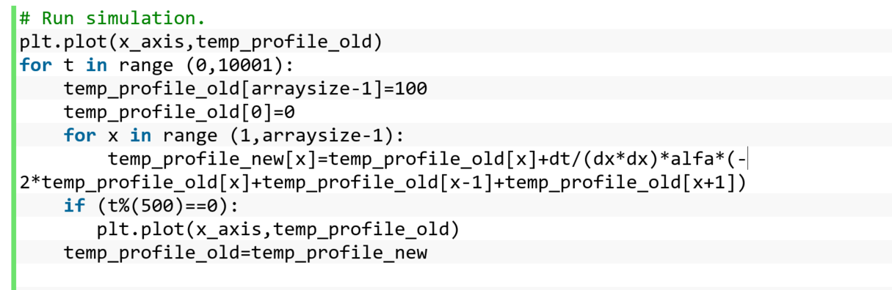
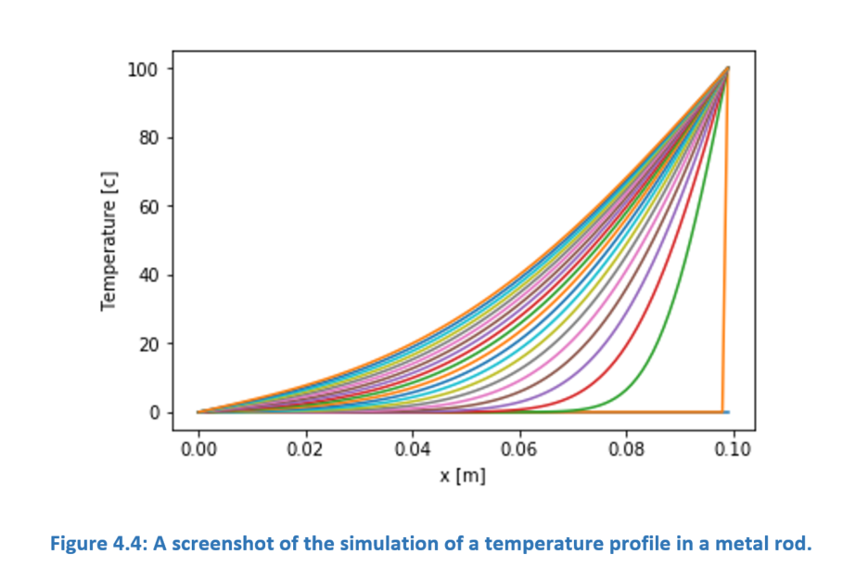
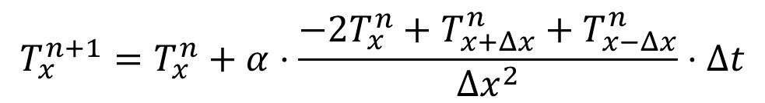
$$T_{x}^{n+1}=T_{x}^{n}+α⋅\frac{−2T_{x}^{n}+T_{x+Δx}^{n}+T_{x−Δx}^{n}}{{Δx}^{2}}⋅Δt$$

Slide 22
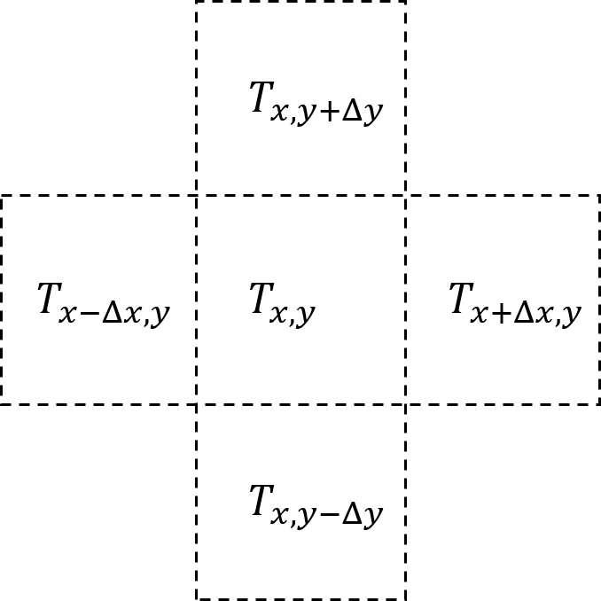
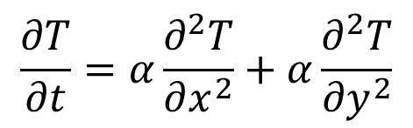
$$\frac{∂T}{∂t}=α\frac{∂^{2}T}{∂x^{2}}$$
2 D ->
$$\frac{∂T}{∂t}=α\frac{∂^{2}T}{{∂x}^{2}}+α\frac{∂^{2}T}{{∂y}^{2}}$$
$$T_{x,y}^{n+1}=T_{x}^{n}+α⋅\frac{−4T_{x,y}^{n}+T_{x+Δx,y}^{n}+T_{x−Δx,y}^{n}+T_{x,y+Δy}^{n}+T_{x,y−Δy}^{n}}{{Δx}^{2}}⋅Δt$$
temp_new[y,x]=temp_old[y,x]+dt/(dx*dx)*alfa*(-4*temp_old[y,x]+temp_old[y,x-1]+temp_old[y,x+1]+temp_old[y+1,x]+temp_old[y-1,x])

Slide 23
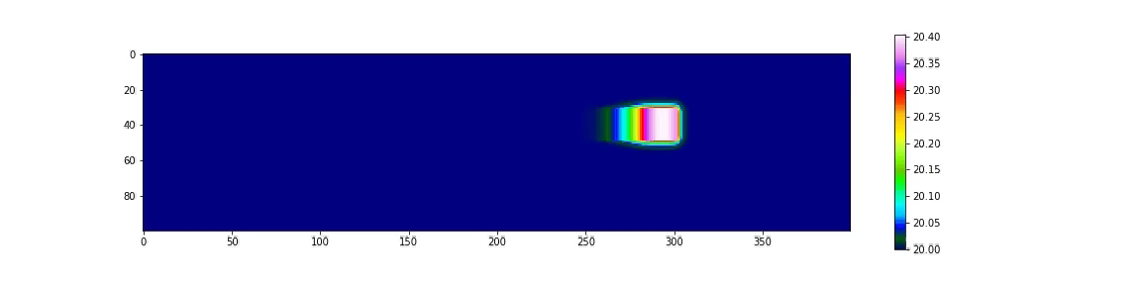
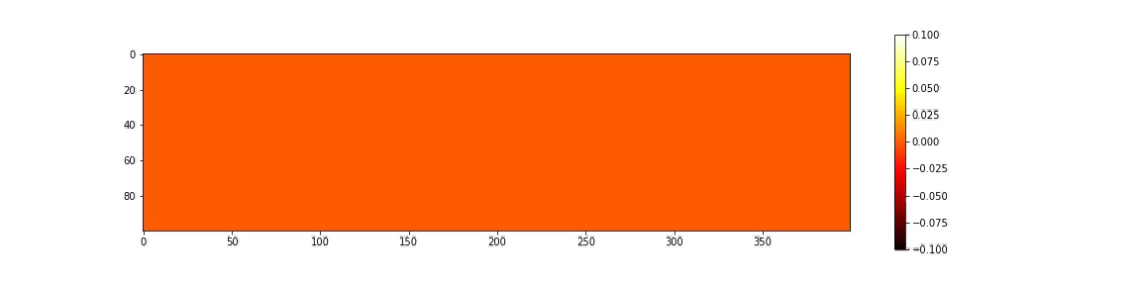
temp_new[y,x]=temp_old[y,x]+dt/(dx*dx)*alfa*(-4*temp_old[y,x]+temp_old[y,x-1]+temp_old[y,x+1]+temp_old[y+1,x]+temp_old[y-1,x])

Slide 24
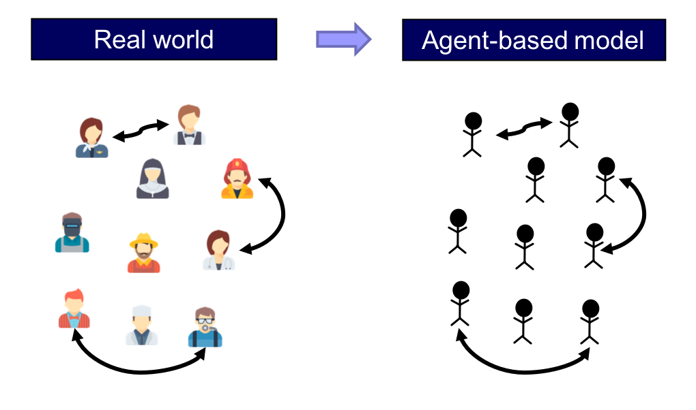
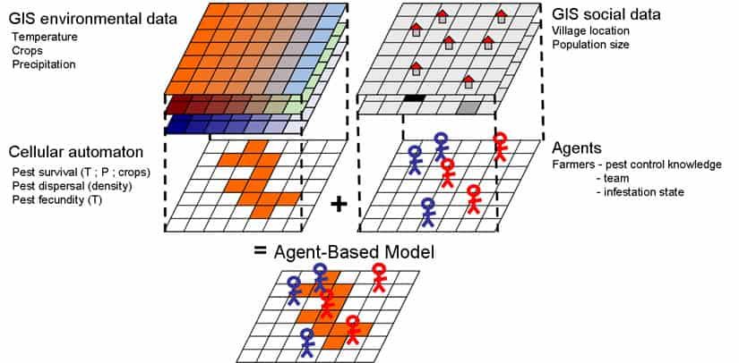

Slide 25
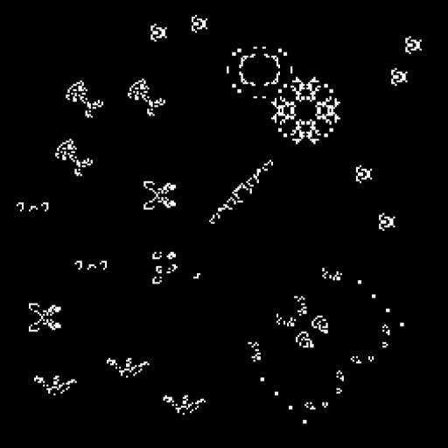
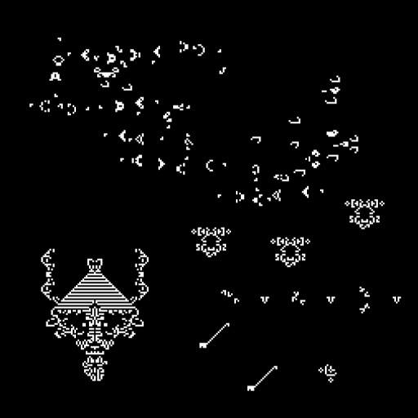

Slide 26

https://www.youtube.com/playlist?list=PLYw0dTiJ5EuGHM3P7VUori1iLQ_DrGn42

Slide 27
Thank you for your attention!
Any questions?

